Slide 1

VEDIC MATHS

Slide 2
Vedic Math's:
Multiplication & Division with powers of 5
Multiplication with series of 9s
Multiplication of 2-digit and 3-digit numbers
Squares of 2-digit numbers: Base Value & Face Value Method
Square root
Cubes
Cube root

Slide 3
MULTIPICATION & DIVISION
MULTIPLICATION BY 5, 25,125
DIVISION BY 5, 25, 125
for 5, multiply number by 10 and divide by 2
for 25, multiply number by 100 and divide by 4
for 125, multiply number by 1000 and divide by 8.
for 5, multiply number by 2 and divide by 10.
for 25, multiply number by 4 and divide by 100.
for 125, multiply number by 8 and divide by 1000.

Slide 4









APPLICATIONS
1. Find the product 36 x 25?
A) 935 B) 765 C) 900 D) 245
2. Find the value of 124*125?
A) 13400 B) 14500 C) 15500 D) 18750
Notes:
Difficulty level: Easy
Option-C
Option-C(Compulsory)

Slide 5







APPLICATIONS
3. Find the value of 1500 / 125?
A) 11 B) 8 C) 12 D) 14
4. Find the value of 147 / 25?
A) 6.98 B) 6.88 C) 5.89 D) 5.88
Notes:
Difficulty level: Easy
3. Option-C(Compulsory)
4. Option-D(Compulsory)

Slide 6













MULTIPLICATION OF NUMBERS WITH 11
To multiply any number with 11
Step 1:- Write the last digit as it is
Step 2:- Add last digit to next digit and write the unit digit as it is and carry forward rest and so on
Step 3:- Write the last digit as it is
For example :- 23*11
Step 1:- Keep last digit as 1
Step 2:- Add 3+2 =5
Step 3:- Write starting digit as 2
So answer will be 253

Slide 7












APPLICATIONS
5.Find the value of 79*11?
A) 869 B) 789 C) 909 D) 809
6.Find the value of 123*111?
A) 13633 B) 13653 C) 13333 D) 12933
Notes:
Difficulty level: Easy
Option-A (Compulsory)
Option- B (Compulsory)

Slide 8











APPLICATIONS
7. Find the value of 249*11?
A)2759 B) 2739 C) 2699 D) 2679
8.Find the value of 849*11?
A) 9289 B) 9319 C) 9329 D) 9339
Notes:
Difficulty level: easy
3. Option-B
4. Option-D

Slide 9
MULTIPLICATION OF NUMBERS WITH 9,99 & 999…
To multiply any number with 9,99 & 999…
Step 1:- Write number of zeroes equal to number of 9s on the right hand side of the number to be multiplied
Step 2:- Now subtract the number to be multiplied from this number
For example:- 8*9
Step 1 :- Write one zero with 8 to make the number as 80
Step 2 :- Now subtract 8 from 80 i.e 80-8 = 72
So 8*9 = 72

Slide 10










APPLICATIONS
9.Find the value of 257*9?
A) 2353 B) 2303 C) 2313 D) 2363
10.Find the value of 58*99?
A) 5632 B) 6182 C) 6822 D) 5742
Notes:
Difficulty level: Easy
Option-C (Compulsory)
Option-D

Slide 11
APPLICATIONS
11. Find the value of 436*99?
A)39452 B) 43164 C) 44724 D) 42492
12. Find the value of 689*999?
A)687431 B) 688411 C) 688311 D) 688321
Notes:
Difficulty level: Moderate
3. Option-B (Compulsory)
4. Option-C

Slide 12
MULTIPLICATION OF TWO DIGIT NUMBERS (CRISS CROSS METHOD)
Step 1:- First of all multiply the last digits and keep the unit digit only and carry forward rest
Step 2:- Now cross multiply the digits and again keep the unit digit only
Step 3:- Now again multiply the starting digits.
It is shown on the next slide with an example

Slide 13
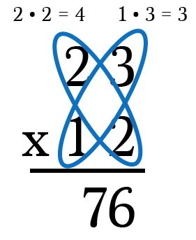
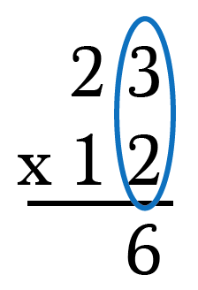
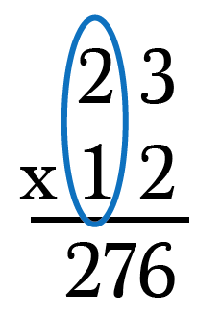
MULTIPLICATION OF TWO DIGIT NUMBERS (CRISS CROSS METHOD)

Slide 14
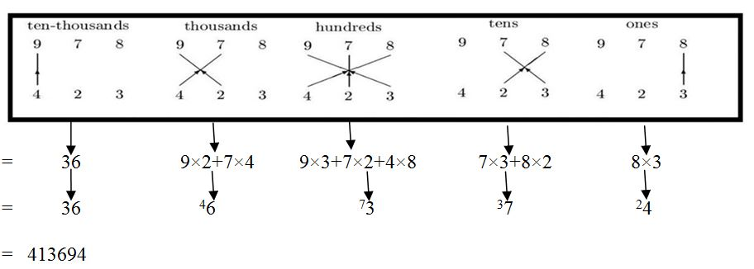
MULTIPLICATION OF THREE DIGIT NUMBERS (CRISS CROSS METHOD)
Multiplication of three digit numbers are explained in the given steps

Slide 15


APPLICATIONS
13.Find the value of 85*46?
A) 3910 B) 4112 C) 4052 D) 4132
14.Find the value of 42*48?
A) 2026 B) 2096 C) 2016 D) 2116
Notes:
Difficulty level: easy
Option-A(Compulsory)
Option-C

Slide 16








APPLICATIONS
15. Find the value of 237*314?
A) 80228 B) 80178 C) 80128 D) 74418
16. Find the value of 786*549?
A) 431574 B) 431514 C) 431534 D) 431554
Notes:
Difficulty level: Moderate
3. Option-D (Compulsory)
4. Option-B

Slide 17











SQUARE
For Squares of 2-digit numbers
Using Base value
Take base as 40.
So, square will be = (44+4)*40 +4² = 1920+16 = 1936
Using Face Value Method
we can use the formula to calculate the square of any two digit number
(ab)² = a² | 2*a*b | b²

Slide 18




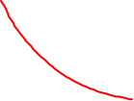


So, according to this method Square of any number
(If Number >Base value)= [(Number+(number - base value)]×Base value+(Number - Base value)²
(If Base value >Number) = [(Number-(base value - number)] ×Base value+(Base value - Number )²
1. FOR BASE VALUE 100
(i)To find the square of 106
As 106 = 100+6
Lets take the base value as 100
So, the square of 106 = (106+6)×Base+6²
= 11200+36= 11236

Slide 19
2. BASE SQUARE 200
To find the square of 206.
As, 2062 = (200+ 6)2
the square will be= (206+6) ×200+6²
= 42400+36 = 42436
3. FOR BASE SQUARES 50
find the square of 41?
As 41 = 50- 9
So, the square will be = (41-9) ×50 + 9²
=1600 + 81 = 1681 Ans.

Slide 20
4. ANY OTHER BASE VALUE
(i) To find the square of 76
As, 76= 70+6
So , square of number = (76+6)×70+ 6²
=5740+36 = 5776
(ii) To find the square of 145
As 145=150-5
So, square of number = (145-5) ×150 + 5²

Slide 21
SQUARE
For Squares of three digit numbers
Select any number from 100-999 :- (588)^2
Step 1:- Take the difference of this number and the nearest number ending with zero. Lets take that number be 600, so difference will be 600-588 = 12
Step 2:- Take square of this difference and that will be 12^2 = 144
Step 3:- Now first add and then subtract the difference from step 1. i.e. 600 and 576
Step 4:- multiply 600 and 576 and then add 144(from step 2) in the result, so it will become (588)^2 = 576*600 + 144 = 345600+144 = 345744
OR
Using Base value
As 588=600-12, so take the base value as 600.
So, square of the number will be= (588-12)*600 +12² = 345600+144 = 345744

Slide 22
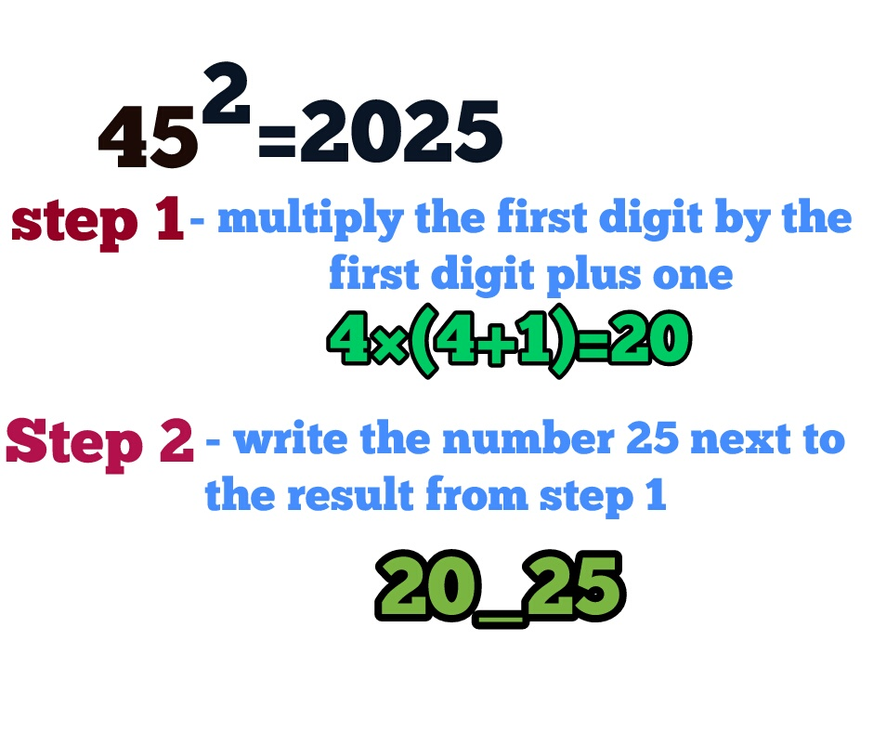











SQUARE OF NUMBERS ENDING WITH 5

Slide 23









APPLICATIONS
17.Find the square of 46?
A) 2116 B) 2378 C) 2216 D) 2316
18.Find the square of 396?
A) 156216 B) 156816 C) 152664 D) 161664
19.Find the square of 112?
A) 11544 B) 12544 C) 11344 D) 12444
Notes:
Difficulty level: Moderate
Option-A (Compulsory)
Option –B (Compulsory)
Option – B (Compulsory)

Slide 24
SQUARE ROOT SHORTCUTS (For Perfect Square Numbers Only)
Step 1: Check unit digit of the no. (in pair).
Step 2: Select whose square less than remaining no.
Step 3: Multiply no. with consecutively next no.
Step 4: Compare & select
Number | Square | Last digit
1 | 1 | 1
2 | 4 | 4
3 | 9 | 9
4 | 16 | 6
5 | 25 | 5
6 | 36 | 6
7 | 49 | 9
8 | 64 | 4
9 | 81 | 1
Example:12544
11 2 or 8
11²<125<12²
Now, 11*12 = 132
125<132; So, we’ll choose the smaller number i.e. 11.
Answer will be 112

Slide 25














APPLICATIONS
20.Find the square root of 14641?
A) 121 B) 91 C) 111 D) 141
21.Find the square root of 233289?
A) 587 B) 377 C) 483 D) 733
Notes:
Difficulty level: Moderate
Option-A (Compulsory)
Option-C (Compulsory)

Slide 26






APPLICATIONS
22. Find the square root of 19321?
A) 141 B) 149 C) 139 D) 131
23. Find the square root of 17424?
A) 132 B) 128 C) 142 D) 148
Notes:
Difficulty level: moderate
3. Option-C (Compulsory)
4. Option-A

Slide 27
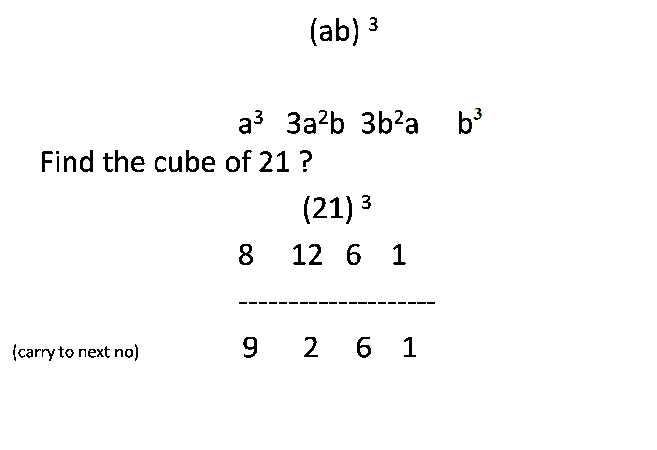
CUBE : SHORTCUTS

Slide 28
APPLICATIONS
24. Find the Cube of 17?
4179 B) 4963 C) 3821 D) 4913
25. Find the Cube of 24?
A) 14178 B) 14964 C) 13824 D) 13148
26. Find the Cube of 73?
A) 384131 B) 389017 C) 413141 D) 361487
Notes:
Difficulty level: moderate
1. Option – D (Compulsory)
2. Option-C (Compulsory)
3. Option-B

Slide 29
CUBE ROOT SHORTCUTS
Step 1: Check unit digit and write its corresponding last digit number
Step 2: Ignore the last three digits
Step 3:Select whose cube is less than or equal to the remaining digit.
Step 4: Write that number with the corresponding number
Number | Cube | Last digit
1 | 1 | 1
2 | 8 | 8
3 | 27 | 7
4 | 64 | 4
5 | 125 | 5
6 | 216 | 6
7 | 343 | 3
8 | 512 | 2
9 | 729 | 9
Example:110592
8
4³
Now, 48 will be the answer

Slide 30
APPLICATIONS
27.Find the cube root of 5832?
A) 14 B) 18 C) 16 D) 22
28.Find the cube root of 24389?
A) 33 B) 43 C) 23 D) 29
Notes:
Difficulty level: easy
Option- B
Option- D (Compulsory)

Slide 31
APPLICATIONS
29.Find the cube root of 13824?
A) 28 B) 34 C) 14 D) 24
30.Find the cube root of 157464?
A) 52 B) 48 C) 54 D) 58
Notes:
Difficulty level: moderate
3. Option-D
4. Option-C (Compulsory)

Slide 32


